Slide 1



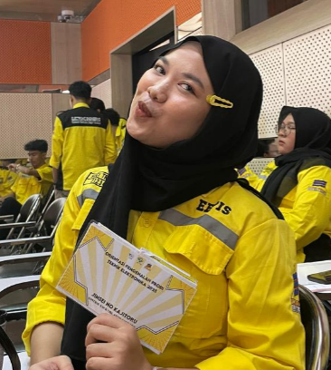
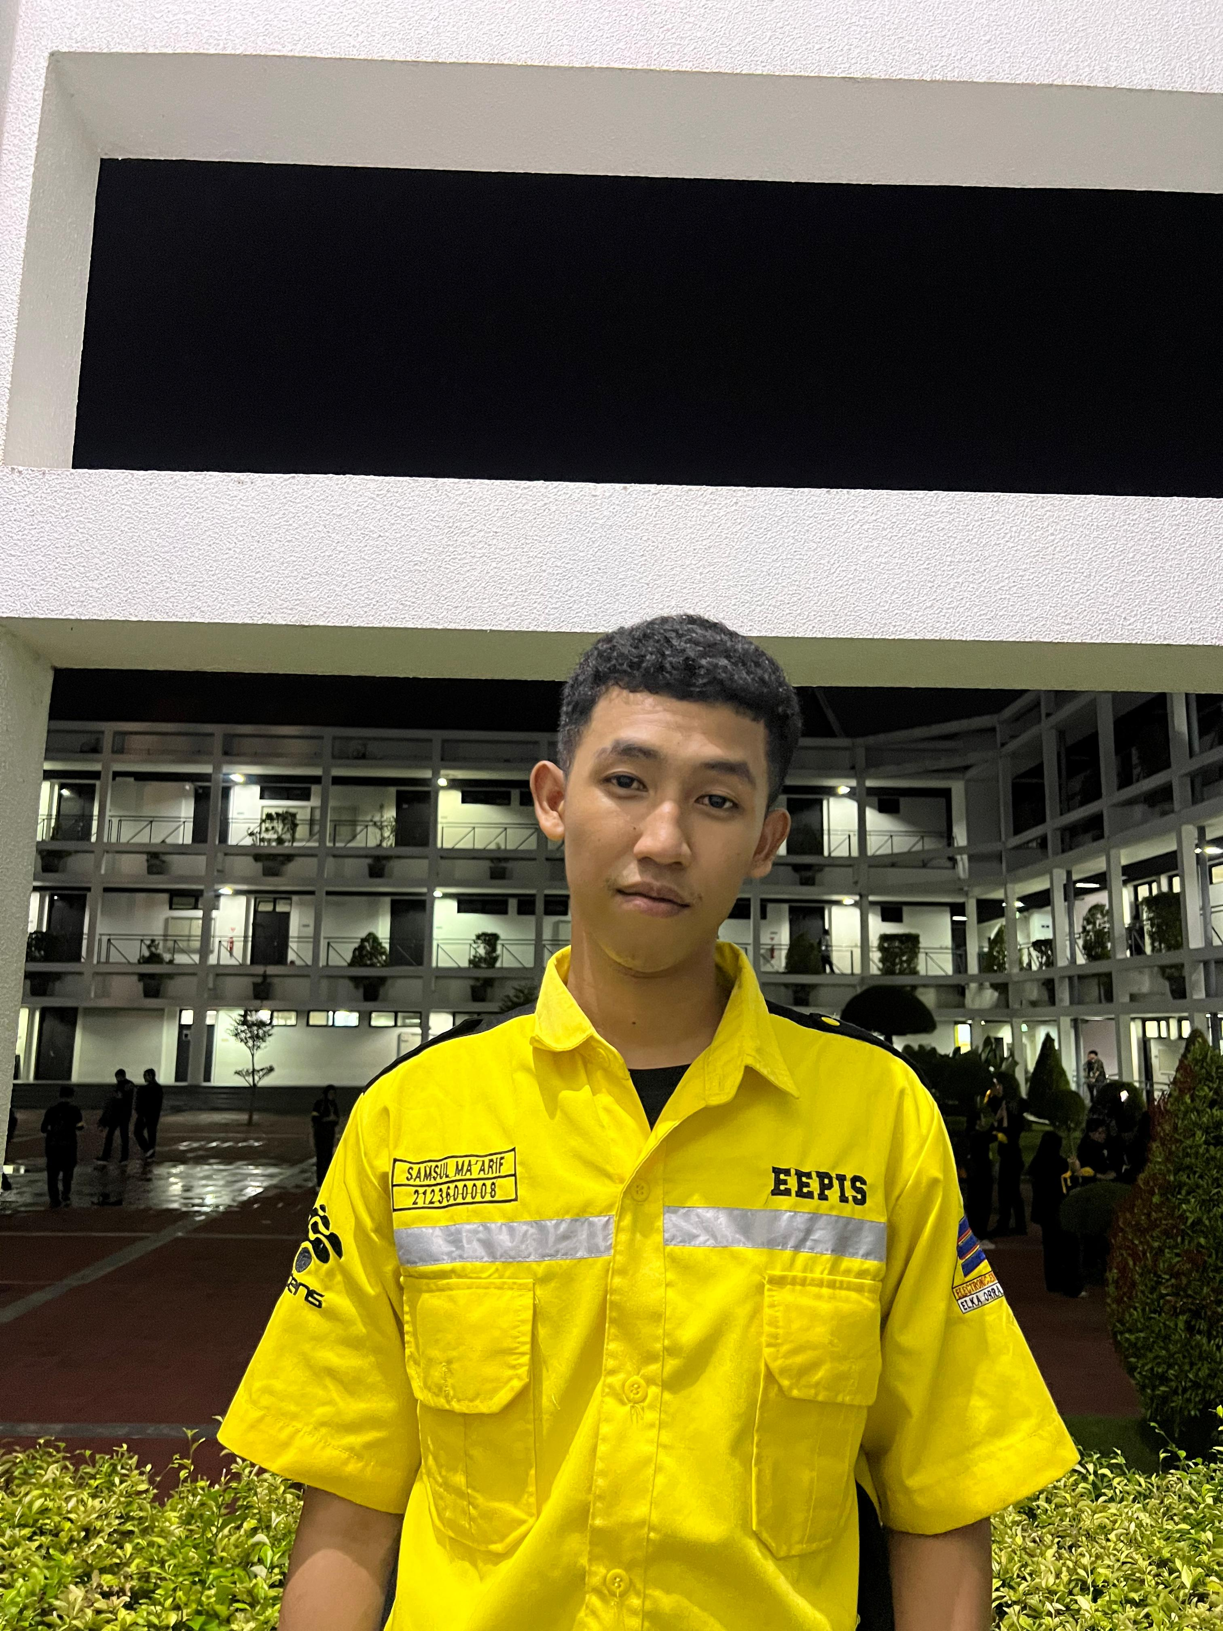
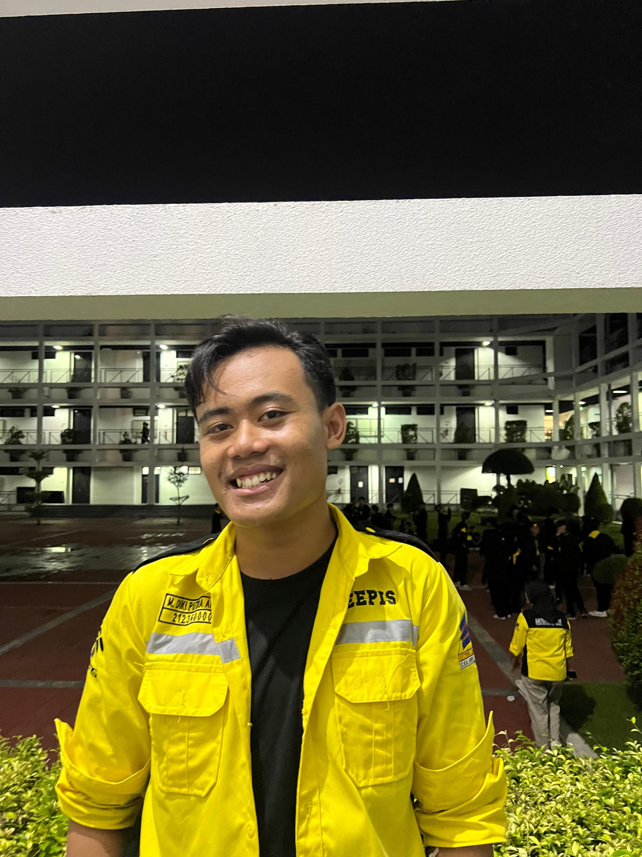
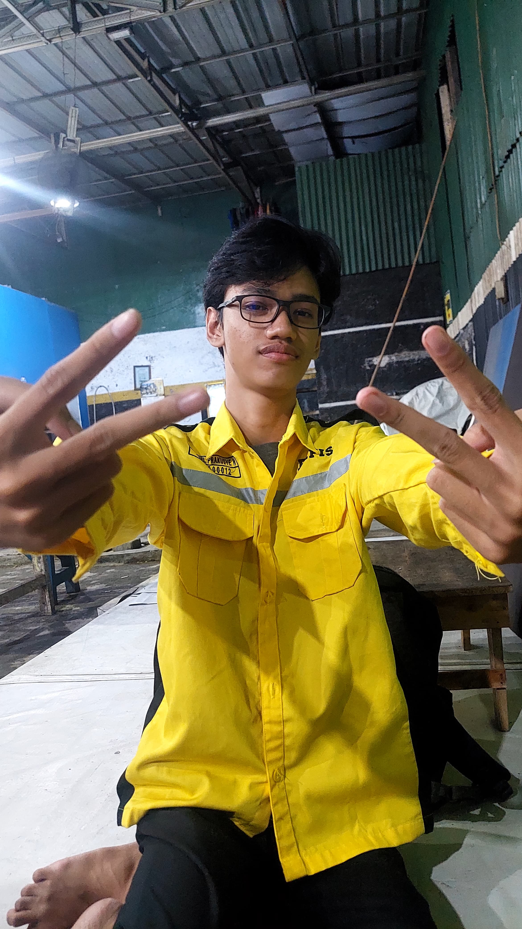
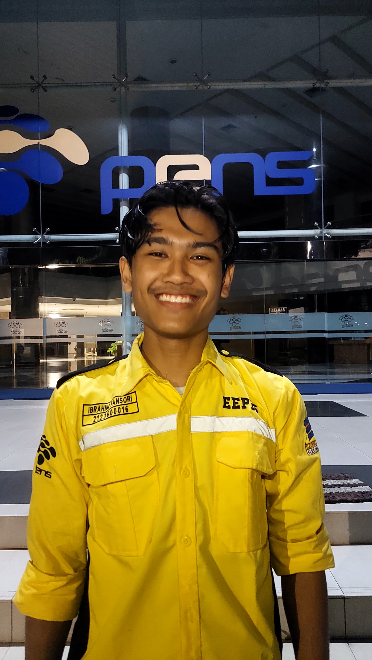
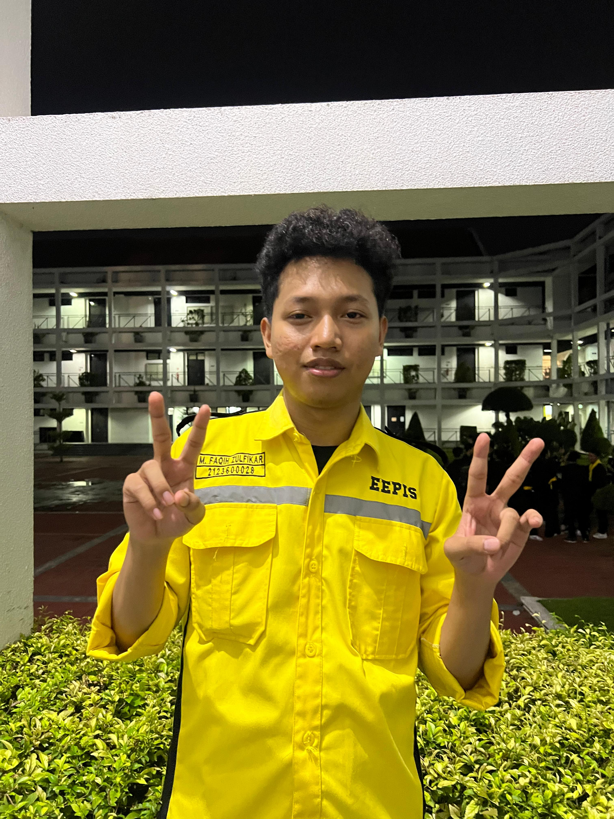
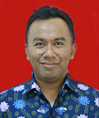
Smart Trolley for Efficient Checkout Utility
OUR STECU TEAM
Suci Tri Rahayu
2123600002
Samsul Ma'arif 2123600008
M. Diki Putra A. 2123600009
Project Mikrokontroller
M. Daniel P. 2123600012
Ibrahim Fansori 2123600016
M. Faqih Zulfikar 2123600028
2 D4 ELEKTRONIKA A
Dosen Pengampu
Akhmad Hendriawan ST, MT
197501272002121003
POLITEKNIK ELEKTRONIKA NEGERI SURABAYA

Slide 2
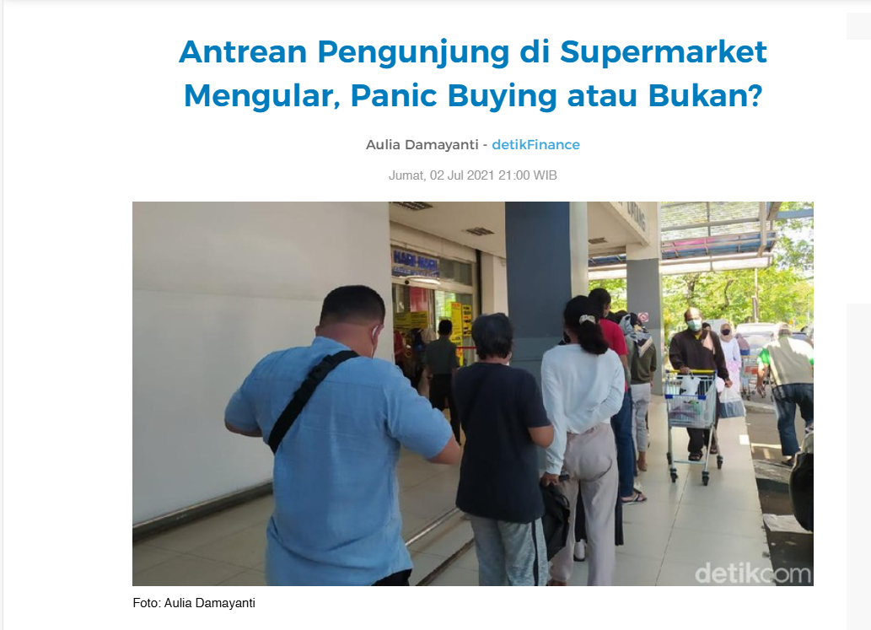
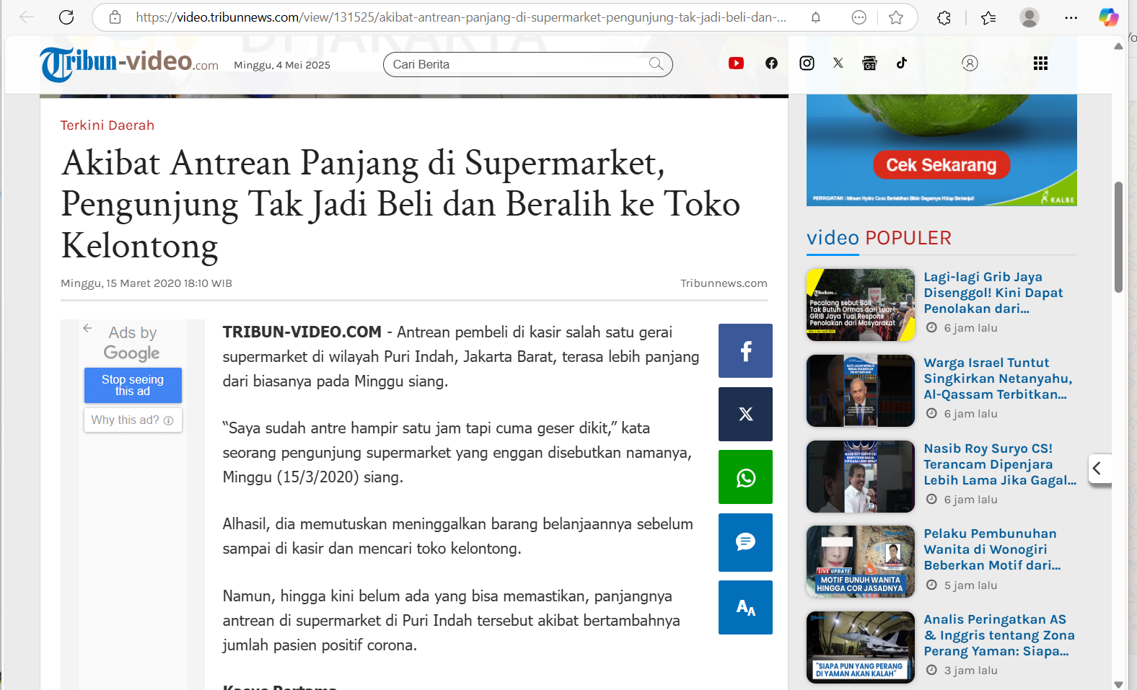
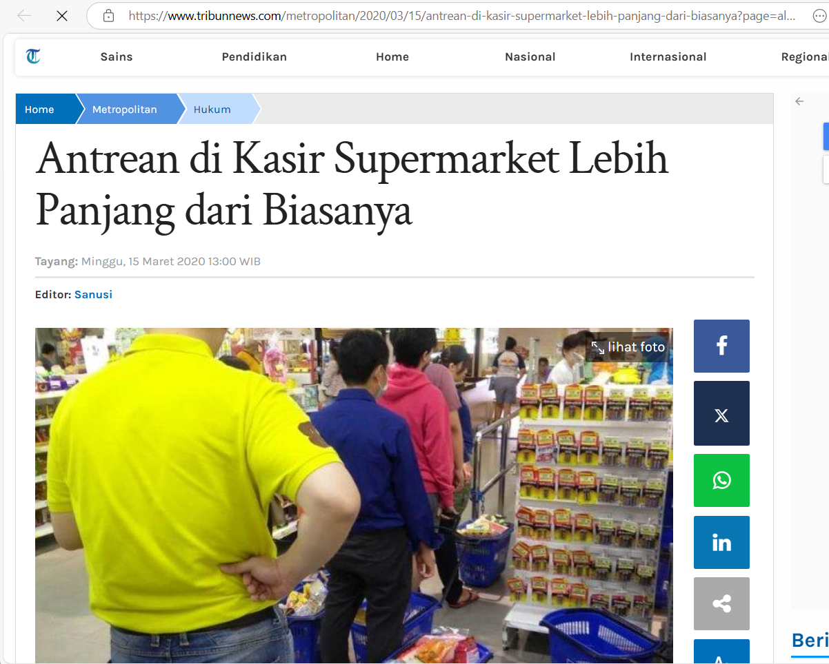
Latar Belakang

Slide 3
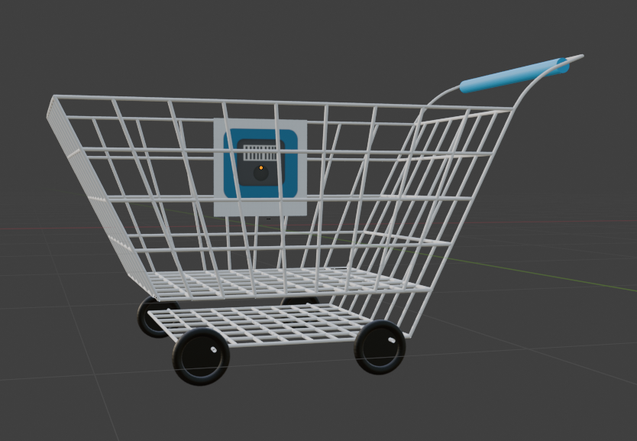
3D Design
SMART TROLLEY

Slide 4
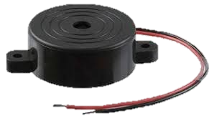
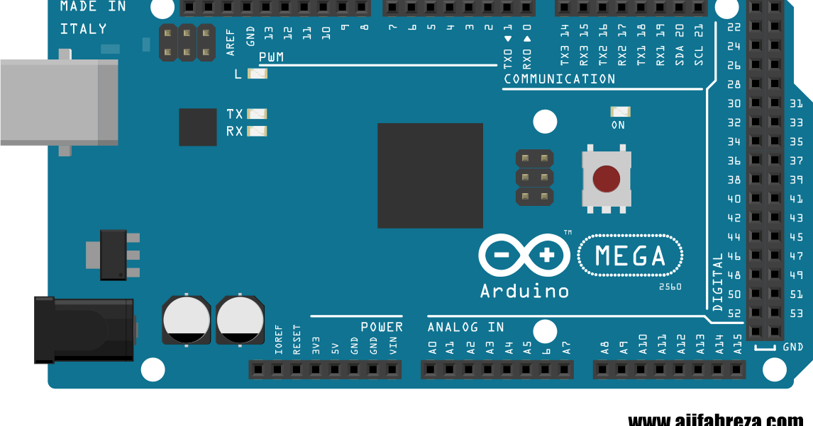
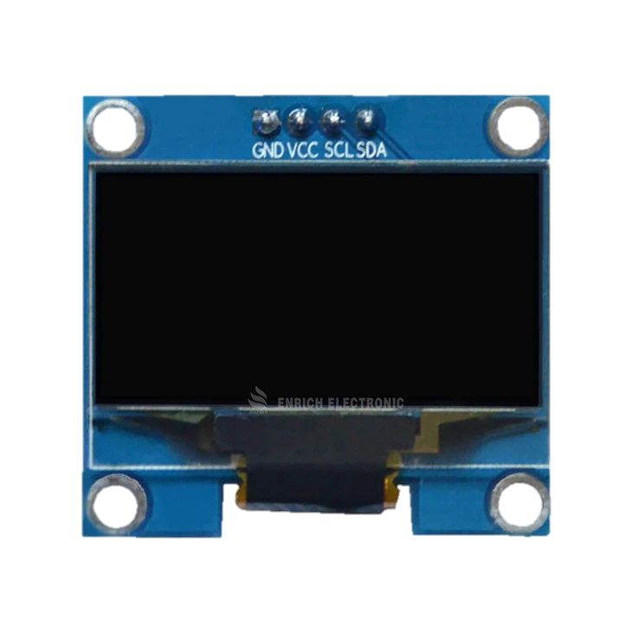
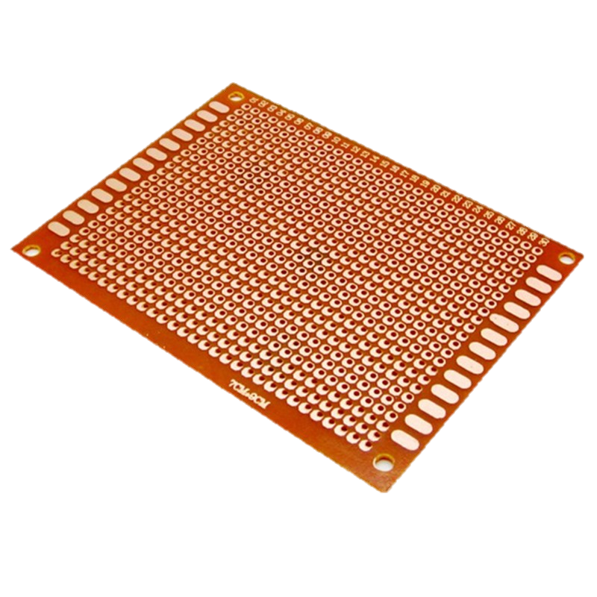
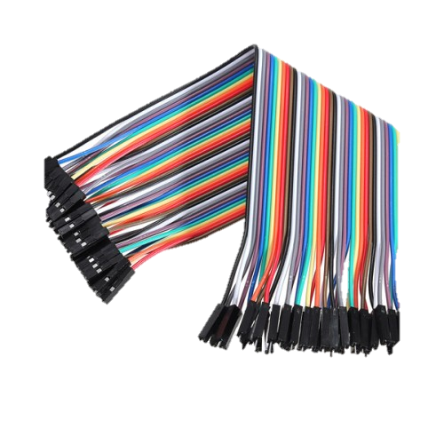
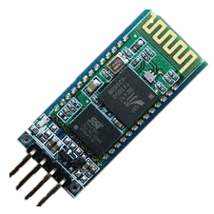
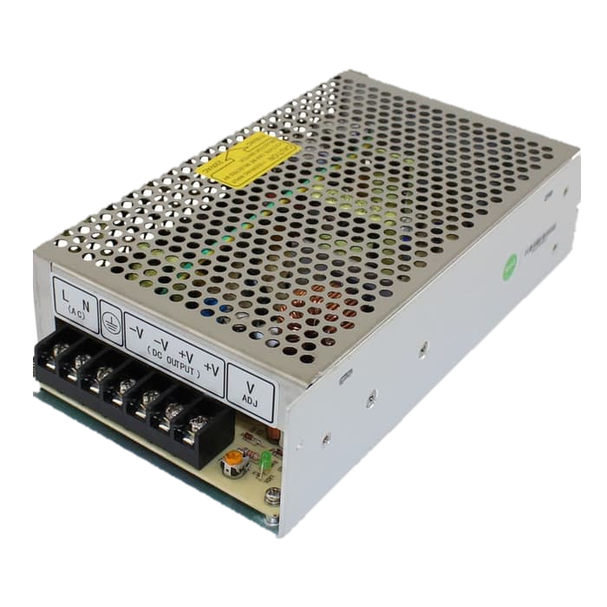
Alat & Bahan
04
Buzzer
01
Arduino Mega 2560
05
PCB + Kabel Jumper
02
Layar OLED 128x64
06
Power Supply
Modul Bluetooth HC-06
03

Slide 5
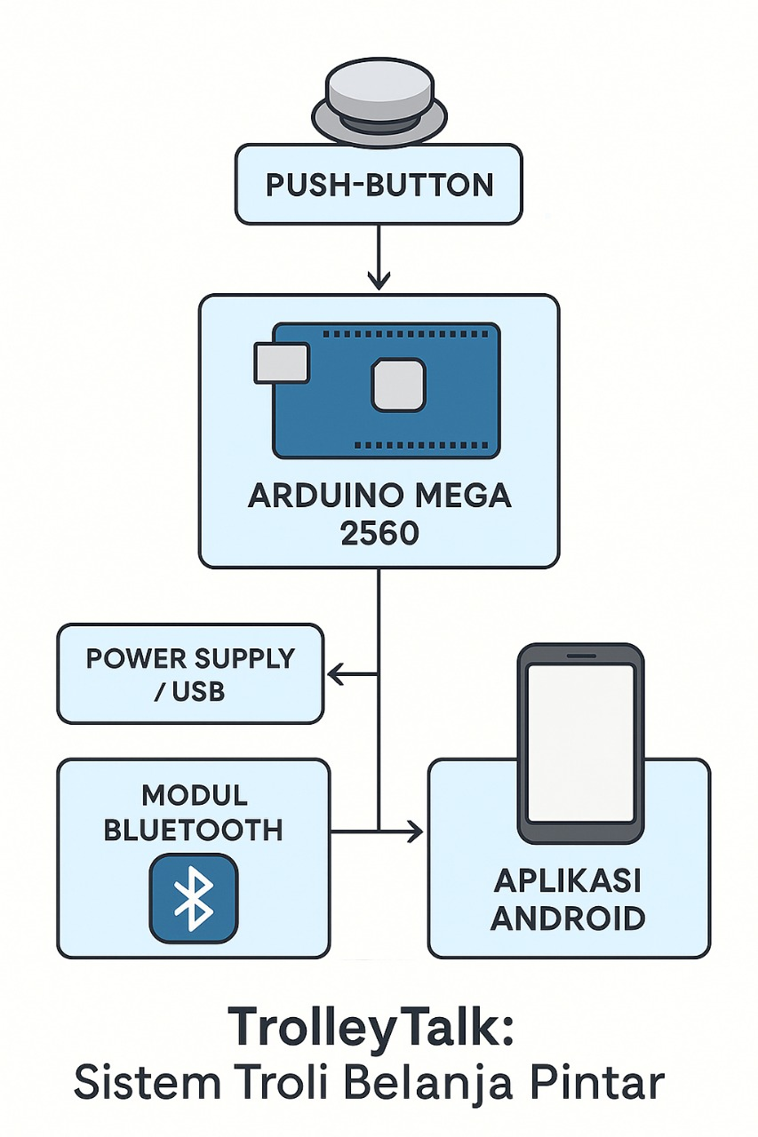
Blok Diagram

Slide 6
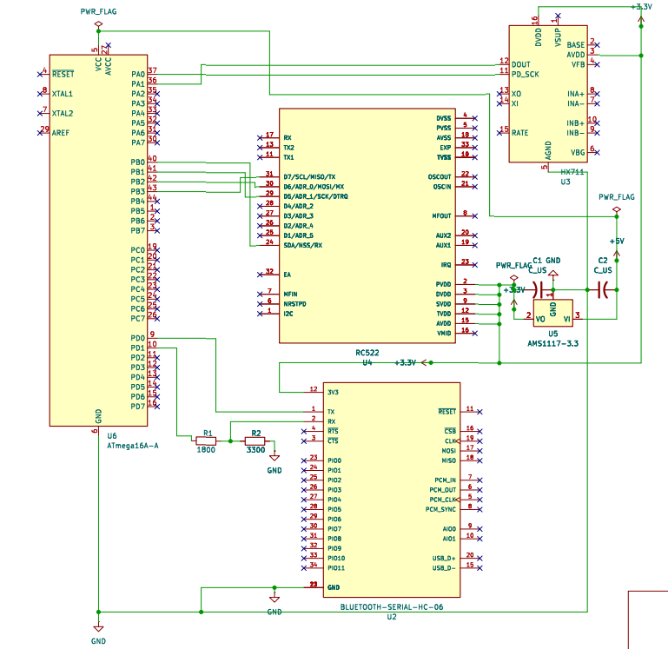
SCHEMATIC

Slide 7
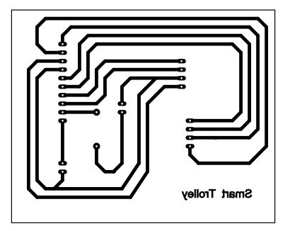
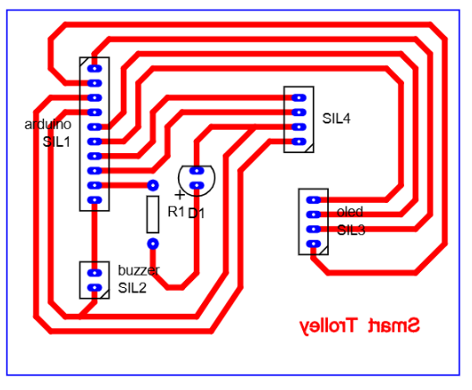
Design PCB

Slide 8
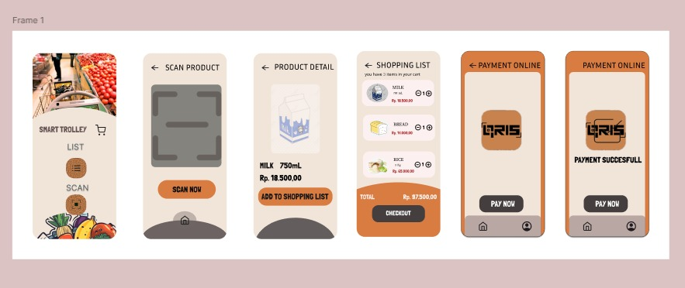
Tampilan Gui

Slide 9
Thanks!

